Slide 1
IoT CHARACTERISTICS AND RELIABILITY ISSUES

Slide 2
RELIABILITY ISSUES
With the advancement in infrastructure and wireless communication, growth of new communication aware devices, and with the introduction of cloud computing paradigm, Internet of Things-based applications are emerging.
For example, smart, network accessible cameras can be placed at strategic locations in a cluster of buildings or on streets
, smart meters may be installed in a power-grid, tiny embedded devices can be used for health monitoring,
vehicles in a city can be equipped with GPS-based sensors
, and static wireless sensors can be embedded in modern appliances like a television or a refrigerator.
These network-enabled devices can run distributed processes, which in turn can coordinate, exchange data, and take critical decisions in real time. Such a system is expected to be deployed once and be operational forever.

Slide 3
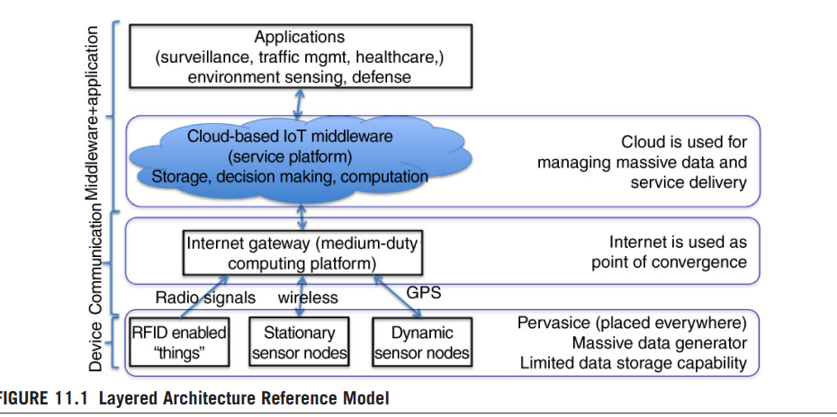
IoT ARCHITECTURE IN BRIEF

Slide 4
IoT ARCHITECTURE IN BRIEF
Device layer: The lowest layer in Fig. 11.1 consists of devices with a low to moderate compute and communication capability. These devices are typically battery operated, and can execute tinyOS.
Communication layer: The devices transmit data through WIFI, GSM/GPRS, Bluetooth, and radio frequency for RFID-enabled devices. The communication layer comprises devices that are responsible for reliable transmission of data.
Application layer: In this layer, an IoT middleware resides, with which the devices interact to exchange data.

Slide 5
IoT ARCHITECTURE IN BRIEF
Different Categories of Applications
We can classify IoT applications into the following categories from reliability and availability perspective:
Zero tolerance:
When an IoT system is placed in a mission critical scenario, specifically in the health care domain, where network aware devices monitor the health of the patient, or a network-enabled pacemaker device that interacts with a larger health-care platform, the system components do not tolerate any failure

Slide 6
IoT ARCHITECTURE IN BRIEF
Restartable:
Here the IoT system can tolerate a faulty component or event the entire system (though undesirable) to restart without any disastrous impact.
For instance, an IoT system for urban transport, having components embedded in vehicles, can afford to restart, if the embedded component fails.
Error Tolerant Here the nature of the application is such that a part of the system can tolerate the erroneous input for some time, within the user-defined safety limit before getting it fixed

Slide 7
FAILURE SCENARIOS
Infrastructure Fault
1. In a given IoT application scenario, the network-enabled devices ought to be embedded in a specific environment to gather and process data stream. The devices can fail due to the physical condition and interference with the environment in which they operate. Such an operating condition can reduce the life of such devices drastically due to the physical deterioration.
2. The external environment may provide unexpected inputs to IoT entities resulting in a computation failure in the device
3. The processors of these devices have been designed keeping a small form-factor in mind rather than making them highly fault-tolerant. Thus these devices can be much more fault-prone than a normal computer.
4. Many a times these devices run on a battery which can severely limit their compute time and can cause unexpected termination of a computation

Slide 8
FAILURE SCENARIOS
Interaction Fault
Network-enabled devices and appliances have widely varying compute capabilities.
When these devices are made to communicate with each other and share data, there can be operational failures due to several reasons:
1. The entire network or the communication components can fail.
Consider the same scenario of electronic tracking of animals. Now consider a likely situation where the GPRS backbone fails in the IoT system that is supposed to be used to report the animal tracking data. Such an event can certainly impact the overall system functionality.
2. Due to the heterogeneity of the devices, there could be an “impedance mismatch” of the data being exchanged. An example of such a scenario is the management of vehicular network in a city where the vehicles joining dynamically may not match with the protocol. In such a situation, it will not be possible to interpret the data and take the appropriate action.
3. Interaction faults are also caused by unexpected workload coming from various IoT components.

Slide 9
FAILURE SCENARIOS
Fault in Service Platform
Consider the architecture reference model shown in Fig. 11.1 where the service platform acts as a hub that collects data from various network aware sensor objects and processes the data.
It will integrate many third party products and will be integrated with external partner systems.
The external partner systems of the IoT application middleware can fail or provide incorrect data, which can result in a failure of the middleware.
When the platform fails due to these faults, it will not be able to process the incoming messages and route them

Slide 10
RELIABILITY CHALLENGES
Making Service Available to User
The aim of an IoT application is to provide seemless service experience through a tightly coupled human–device interaction in real time.
Therefore, it is highly important that the availability of the system be judged from the user perspective. This is known as “user perceived availability”

Slide 11
RELIABILITY CHALLENGES
Serviceability of IoT System
It is quite likely for an IoT system to have a set of devices that can dynamically come and join the system.
In such a case, ensuring serviceability without disrupting the ongoing activities is more difficult in the case of IoT devices.

Slide 12
RELIABILITY CHALLENGES
Reliability at Network Level
Most Internet of Things applications for buildings, factories, hospitals, or the power grid are long-term investments that must also be operable for a long time.
The networks can also be unmanaged (eg, home automation, transport applications).
This implies that the network must be able to configure itself as environmental conditions or components in the network itself change so that the information can always be transmitted from one application to the other reliably.

Slide 13
RELIABILITY CHALLENGES
Device Level Reliability
The network level, let us now focus on the embedded devices that are connected via network. Even when the network is reliable, there are scenarios when the applications running on these devices may generate poor quality data, which makes the entire computation unreliable.
Consider a scenario when the device needs to gather image from the physical world where it is embedded. Due to the environmental condition, the quality of the images captured can be below the acceptable level; as a result the associated inferences drawn from the captured images become unreliable. For sensor devices, the environmental condition can result in a bit error.

